Slide 1

Lesson 9:
App architecture (persistence)

Slide 2
About this lesson
Lesson 9: App architecture (persistence)
Storing data
Room persistence library
Asynchronous programming
Coroutines
Testing databases
Summary

Slide 3
Storing data
Notes:
So far, the apps we’ve created primarily display data that was stored in memory in our apps. We can build a far more useful app if we learn how to persist data in local storage on the device in a scalable and flexible way.

Slide 4
Ways to store data in an Android app
App-specific storage
Shared storage (files to be shared with other apps)
Preferences
Databases
Notes:
Android uses a file system that's similar to disk-based file systems on other platforms. The system provides several options for you to save your app data:
App-specific files: Store files that are meant for your app's use only. Examples: structured data files (JSON files), plain text files, media files.
Shared files: Store files that your app intends to share with other apps, such as media or documents.
Preferences: Store private, primitive data in key-value pairs. See SharedPreferences and how to save key-value data.
Databases: Store structured data in a database that’s private to your app.
In this lecture, we’re going to focus on the last option: storing and retrieving local data using a database.
Resources:
Data and file storage overview

Slide 5
What is a database?
Collection of structured data that can be easily accessed, searched, and organized, consisting of:
Tables
Rows
Columns
Example Database
person
_id name age email
car
_id make model year
Notes:
Transition: 1 click
A database is a collection of structured data that can be easily accessed, searched, and organized. Data is stored in tables, and each table holds related fields of information.
For example, we have a person table that holds information related to people. We can have a car table that holds information related to cars in our app. Each table can have any number of rows, with each row representing a single item. The columns describe the type of data held for each row. A single row in the person table represents one person with a name, age, and email address. A single row in the car table represents one car with a make, model, and year.
Each table also has an _id column that provides a unique identifier for each row in the table (called the primary key).
This is a relational database because the structure of the database (with tables, rows, and columns) provides us with the ability to establish relationships and constraints among the data.

Slide 6
Structured Query Language (SQL)
Use SQL to access and modify a relational database.
Create new tables
Query for data
Insert new data
Update data
Delete data
Notes:
To interact with a relational database, we use SQL (or Structured Query Language), which is a domain-specific language for databases.
SQL has a lot of capabilities, but we’ll be focusing on some of the crucial functionality, such as being able create tables in the database, querying for data, inserting and updating data, and deleting data from the database.

Slide 7

SQLite in Android
Store data
Your app
SQLite database
Notes:
Because mobile devices are limited in terms of hardware and computing capabilities, Android uses SQLite, which is based on the SQL standard. SQLite is lightweight, open-source, and ideal for embedded devices, and what you will be using to store data in a database in your Android app.
SQLite supports most of the features of SQL. (To see what’s not supported, check the link below.)
Let’s look at some common SQLite commands you’ll need to know.
Resources:
SQLite Home Page
Query Language Understood by SQLite
SQL Features that SQLite Does Not Implement

Slide 8
Example SQLite commands
Create
INSERT INTO colors VALUES ("red", "#FF0000");
SELECT * from colors;
UPDATE colors SET hex="#DD0000" WHERE name="red";
DELETE FROM colors WHERE name = "red";
Read
Update
Delete
Notes:
Here are example commands for operating on a database table called colors, which holds color names and hexadecimal color codes.
We can insert new rows into the colors table, read existing data from the table, update rows, and also delete rows that match the given criteria.
These Create-Read-Update-Delete operations are also known as CRUD operations. As mentioned earlier, these are the most common interactions you will have with your database.
Note that the capitalized words are SQLite keywords (like INSERT, UPDATE, DELETE, VALUES, WHERE, etc.), so you cannot use these names for table or column names. See the full list of protected keywords in the documentation linked below.
Resources:
Query Language Understood by SQLite
Command Line Shell For SQLite
SQLite Keywords

Slide 9
Interacting directly with a database
No compile-time verification of raw SQL queries
Need lots of boilerplate code to convert between SQL queries data objects
android.database.sqlite
Notes:
Android provides APIs to help you create and manage a SQLite database directly in your app. Interacting directly with the database is powerful, but does require a great deal of time and attention to use properly, and to avoid mistakes. For example, you don’t get compile-time verification of raw SQL queries. You also need to write lots of boilerplate code to convert between SQL queries and data objects.
Fortunately, Android Jetpack introduced the Room persistence library, which offers a layer of abstraction that lets you more easily interact with a database in your app.

Slide 10
Room persistence library
Notes:
The Room persistence library provides an abstraction layer over SQLite to allow for more robust database access, while harnessing the full power of SQLite.

Slide 11
Add Gradle dependencies
dependencies {
implementation "androidx.room:room-runtime:$room_version"
kapt "androidx.room:room-compiler:$room_version"
// Kotlin Extensions and Coroutines support for Room
implementation "androidx.room:room-ktx:$room_version"
// Test helpers
testImplementation "androidx.room:room-testing:$room_version"
}
Notes:
To use the Room library, add these dependencies to your app’s build.gradle file.
The current stable version at the time of this writing is 2.2.5. This (or a subsequent stable version), is what you would define as the room_version (e.g., def room_version = "2.2.5").
Note: For Kotlin-based apps, be sure to use kapt instead of annotationProcessor, and to add the kotlin-kapt plugin (apply plugin: 'kotlin-kapt').
Resource:
Room library

Slide 12
Room
Rest of the app code
Color("#FF0000", "red")
Room
Colors database
Data access object
Color("#4CAF50", "green")
Color("#1155CC", "blue")
Notes:
Room is an object relational mapping library that converts data from their representation in a database into objects that we can directly manipulate in the app code. It can also reverse the process, pushing data from the objects back to the database.

Slide 13
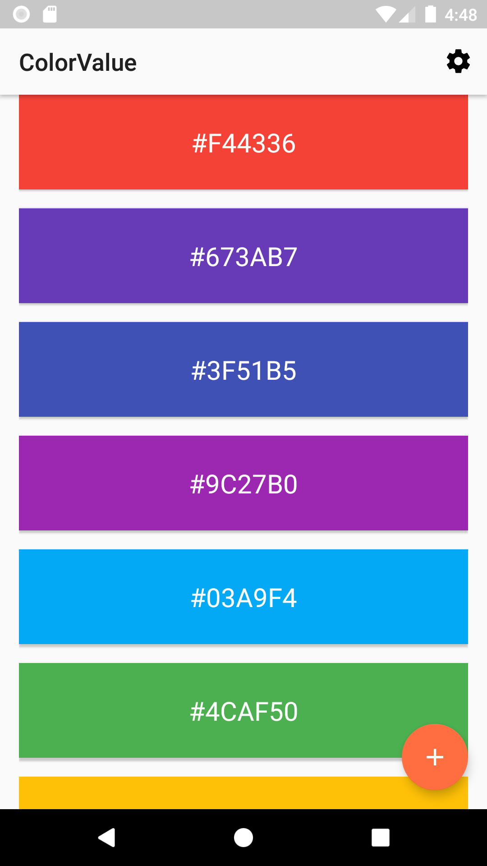
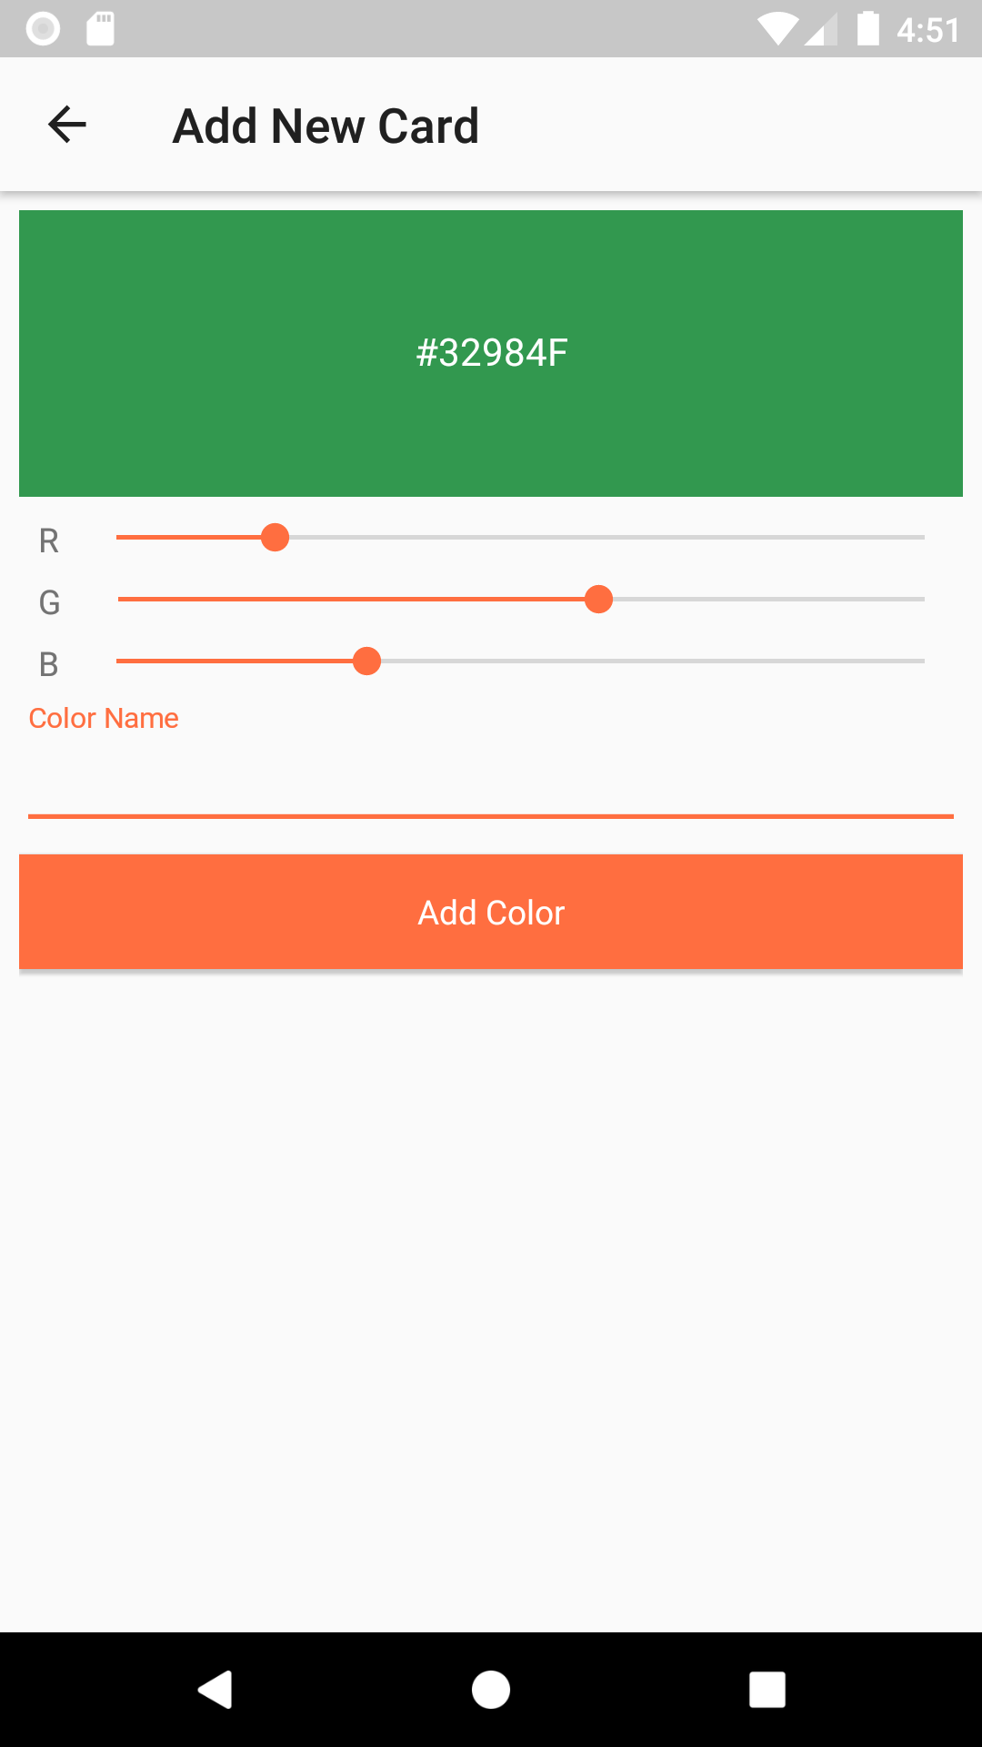
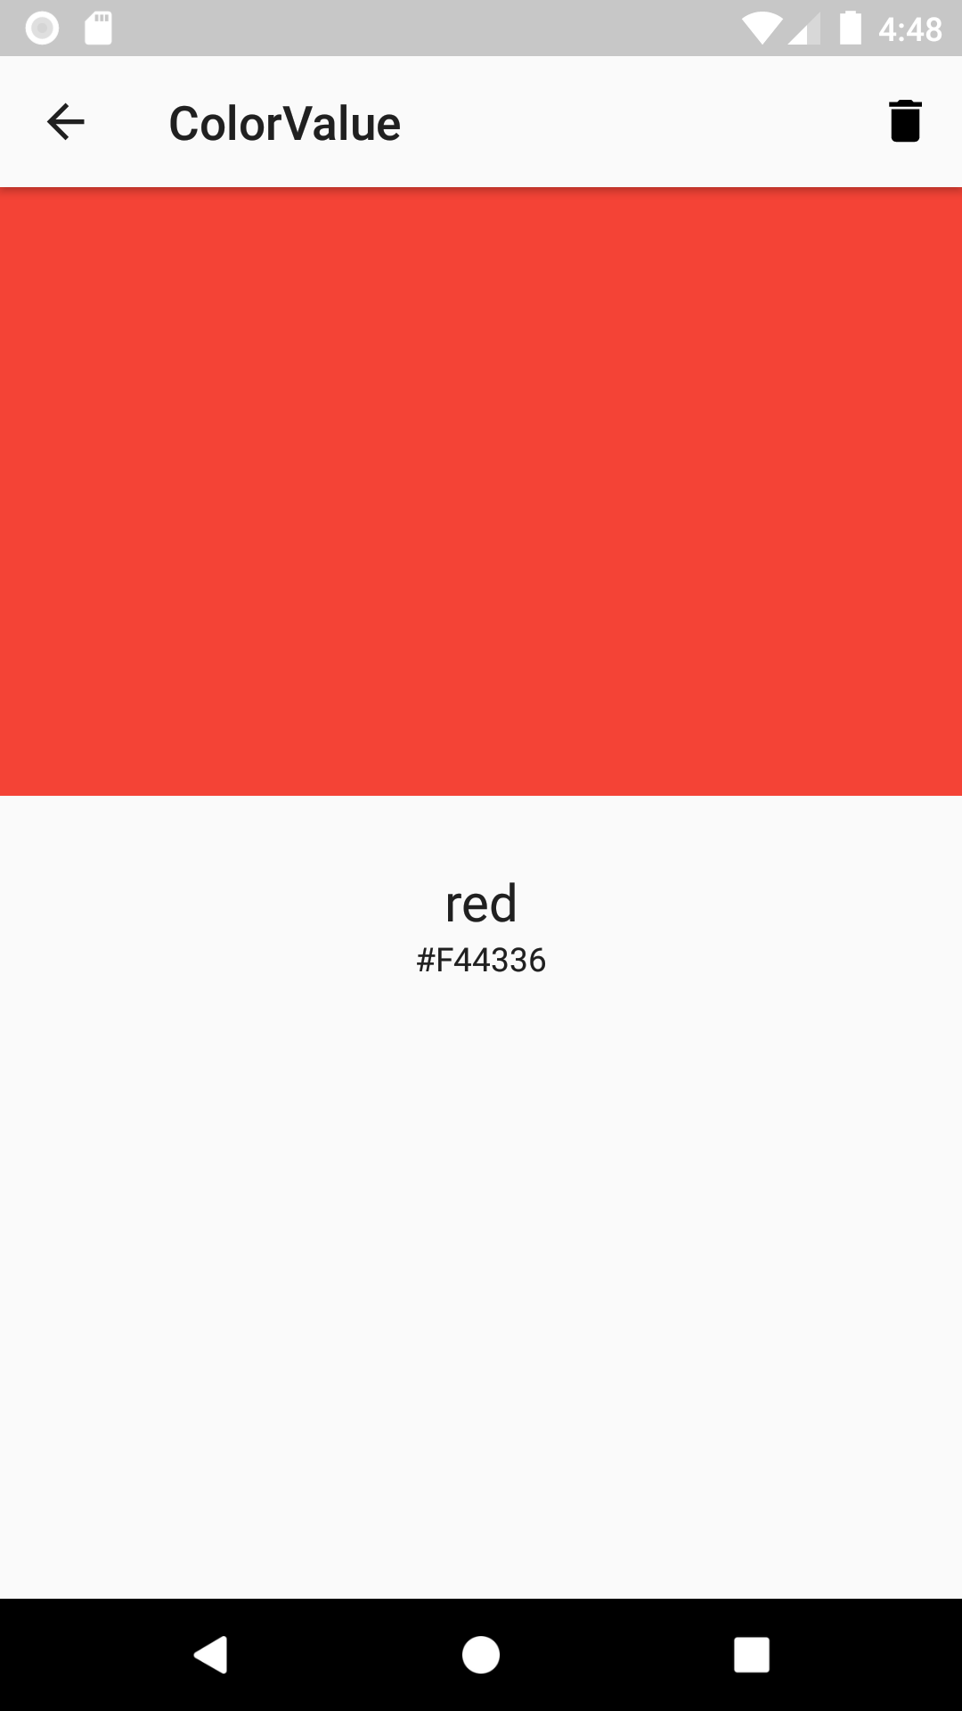
ColorValue app
Notes:
Here’s the sample ColorValue app that we’ll follow in the rest of the lesson. It displays a list of colors, and lets you add your own colors and view individual colors.

Slide 14
Room
Entity Color
DAO ColorDao
Database ColorDatabase
Notes:
There are three major components in Room:
Entity: Represents a table within the database
DAO: Contains the methods used for accessing the database
Database: Contains database holder, and is the main access point for the underlying connection to the app's persisted, relational data
There is no limit on the number of Entity or DAO classes, but they must be unique within the database. In the ColorValue app, we will declare three classes: Color, ColorDao, and ColorDatabase.
Resources:
Database
Defining data using Room entities
Accessing data using Room DAOs
Save data in a local database using Room

Slide 15
Color class
data class Color {
val hex: String,
val name: String
}
Notes:
First, define a Color class that will hold the data for a specific color, including color name and hex color value. Note that we declared it as a data class, but this is not required.
However, to make Kotlin classes meaningful to a Room database, you need to annotate them.
Resource:
Data Classes

Slide 16
Annotations
Provide extra information to the compiler
@Entity marks entity class, @Dao for DAO, @Database for database
Can take parameters
@Entity(tableName = "colors")
Can autogenerate code for you
Notes:
Transition: 1 click
In general, annotations are notes that explain or highlight words or passages in a text. Similarly, in programming languages, annotations attach metadata to your code and can provide extra information to the compiler. (In Java, you may be familiar with seeing the @Override annotation when overriding superclass methods in a subclass.)
Room uses this information to automatically generate code for you.
You can find a complete list of annotations in the Room package summary reference.
Resources:
Improve code inspection with annotations
Annotations
Room package summary reference

Slide 17
Entity
Class that maps to a SQLite database table
@Entity
@PrimaryKey
@ColumnInfo
Notes:
Let’s look at the annotations used with entities, which are classes that map to SQLite tables. Entities are generally implemented as data classes.
Add the @Entity annotation on the class. Use @PrimaryKey to mark a column as the primary key of a table (the field in a database record that determines uniqueness). In simple databases, an auto-incrementing integer is often used.
By default, Room uses the property name to create the column in the database. You can change that with the @ColumnInfo annotation.

Slide 18
Example entity
@Entity(tableName = "colors")
data class Color {
@PrimaryKey(autoGenerate = true) val _id: Int,
@ColumnInfo(name = "hex_color") val hex: String,
val name: String
}
colors
_id hex_color name
Notes:
Transition: 1 click
Let’s add the @Entity annotation on the Color class. By default, Room uses the class name as the database table name. If you want the table to have a different name, set the tableName property of the @Entity annotation. In our case, the table name is called “colors”.
We also add an _id field because each entity must define at least one field as a primary key. Annotate that field with the @PrimaryKey annotation. If you want Room to assign automatic IDs to entities, you can set the @PrimaryKey's autoGenerate property to true.
We want the column to be called “hex_color”, so we add the @ColumnInfo annotation to the hex field and pass in the desired column name.
Resource:
Entity

Slide 19
Data access object (DAO)
Work with DAO classes instead of accessing database directly:
Define database interactions in the DAO.
Declare DAO as an interface or abstract class.
Room creates DAO implementation at compile time.
Room verifies all of your DAO queries at compile-time.
Notes:
To access your app's data using the Room persistence library, you work with data access objects, or DAOs. Define the database interactions you’d like to have in the DAO class, instead of using query builders or direct queries.
Room also verifies all of your queries in Dao classes when the application is compiled, so that if there is a problem in one of the queries, you will be notified instantly. Furthermore, DAOs let you easily mock database access as you test your app.
Resource:
Accessing data using Room DAOs
Dao

Slide 20
Example DAO
@Dao
interface ColorDao {
@Query("SELECT * FROM colors")
fun getAll(): Array<Color>
@Insert
fun insert(vararg color: Color)
@Update
fun update(color: Color)
@Delete
fun delete(color: Color)
Notes:
@Dao marks our interface as a DAO. Note that it contains methods that are annotated with @Query, @Insert, @Update, and @Delete, which are the operations we want to perform on our colors database.

Slide 21
Query
@Dao
interface ColorDao {
@Query("SELECT * FROM colors")
fun getAll(): Array<Color>
@Query("SELECT * FROM colors WHERE name = :name")
fun getColorByName(name: String): LiveData<Color>
@Query("SELECT * FROM colors WHERE hex_color = :hex")
fun getColorByHex(hex: String): LiveData<Color>
Notes:
For each function in the DAO that queries the database, we need a Query annotation to tell the database what to retrieve. The table name (colors) and column names (name and hex_color) correspond to what was declared in the Color entity class.
The query uses a domain-specific-language (DSL) that is very close to SQL commands. One key difference is how you specify parameters in the query. Any parameter the function needs to pass to the query must reference the precise function argument name. For example, in getColorByHex(), if we pass in the hex argument into the query, refer to the argument using “:hex”.
Note: You could create constants for the table and column names.
Resources:
Accessing data using Room DAOs

Slide 22
Insert
@Dao
interface ColorDao {
...
@Insert
fun insert(vararg color: Color)
...
}
Notes:
When you create a DAO method and annotate it with @Insert, Room generates an implementation that inserts all parameters into the database in a single transaction. To allow a variable number of arguments for a function, mark the parameter (usually the last one) with the vararg modifier keyword.
Resources:
Insert
Variable number of arguments (Varargs)

Slide 23
Update
@Dao
interface ColorDao {
...
@Update
fun update(color: Color)
...
}
Notes:
@Update marks a method in a @Dao annotated class as an Update method, to update the specified Color.
Resource:
Update

Slide 24
Delete
@Dao
interface ColorDao {
...
@Delete
fun delete(color: Color)
...
}
Notes:
@Delete marks a method in a @Dao annotated class as a Delete method, to delete the specified Color from the database.
Resource:
Delete

Slide 25
Create a Room database
Annotate class with @Database and include list of entities: @Database(entities = [Color::class], version = 1)
Declare abstract class that extends RoomDatabase: abstract class ColorDatabase : RoomDatabase() {
Declare abstract method with no args that returns the DAO: abstract fun colorDao(): ColorDao
Notes:
Finally, with the DAO declared, we can create our Room database. Annotate the class with @Database and include the list of entities. The entities property of the @Database annotation declares which objects will be stored in this database.
Declare this as an abstract class (ColorDatabase) that extends from RoomDatabase. Within the class, include an abstract method that takes no arguments and returns the class that was annotated with @Dao. You’ll receive an implementation of the ColorDatabase class via Room.databaseBuilder or Room.inMemoryDatabaseBuilder.
Resource:
Database
Save data in a local database using Room

Slide 26
Example Room database
@Database(entities = [Color::class], version = 1)
abstract class ColorDatabase : RoomDatabase() {
abstract fun colorDao(): ColorDao
companion object {
@Volatile
private var INSTANCE: ColorDatabase? = null
fun getInstance(context: Context): ColorDatabase {
...
}
}
...
Notes:
This is what the ColorDatabase class looks like. Inside it, we declare a singleton to get an instance of the database. If your app runs in a single process, you should follow the singleton design pattern when instantiating a Database object. This is because each RoomDatabase instance is fairly expensive, and you rarely need access to multiple instances within a single process.
@Volatile: The reason we are making our INSTANCE variable volatile is so that its value is never cached, and all read and write operations are done directly in main memory. This ensures that the data integrity (i.e., any changes made to the instance of the database) is visible to all other threads immediately, and prevents, for example, two threads updating the same entity in a cache.
For the implementation of the getInstance() method that returns a ColorDatabase, see the next slide.

Slide 27
Create database instance
fun getInstance(context: Context): ColorDatabase {
return INSTANCE ?: synchronized(this) {
INSTANCE ?: Room.databaseBuilder(
context.applicationContext,
ColorDatabase::class.java, "color_database"
)
.fallbackToDestructiveMigration()
.build()
.also { INSTANCE = it }
}
}
Notes:
We use Room.databaseBuilder() to create a database using the application context, ColorDatabase class, and the database name.
Synchronized: Multiple threads can potentially request a database instance at the same time, resulting in two or more databases instead of one. Although it's not likely to happen with this sample app, it is possible for more complex apps. Wrapping the code so that the database is synchronized means that only one thread of execution at a time can enter this block of code, ensuring that the database is only initialized once.
If it's acceptable to lose existing data when a migration path is missing, call the fallbackToDestructiveMigration() builder method when you create the database. It tells Room to destructively recreate the tables in your app's database when it needs to perform an incremental migration where there is no defined migration path.
Resource:
Migrating Room databases

Slide 28
Get and use a DAO
Get the DAO from the database:
val colorDao = ColorDatabase.getInstance(application).colorDao()
Create new Color and use DAO to insert it into database:
val newColor = Color(hex = "#6200EE", name = "purple")
colorDao.insert(newColor)
Notes:
Transition: 1 click
Now let's add some data to our database.
First, create the instance of DAO named colorDao using the getInstance() method, which will make sure it provides us with singleton instance.
Now add a color instance newColor, and add it to your DAO instance using the insert() method. This adds the newColor defined in your database.
Now you can use the DAO object to insert, update, search or query your database.

Slide 29
Asynchronous programming

Slide 30
Long-running tasks
Download information
Sync with a server
Write to a file
Heavy computation
Read from, or write to, a database
Notes:
If you need to do some of these long-running tasks, you shouldn’t do them on the main thread or your app may become unresponsive to the user. This introduces the need for doing work asynchronously.

Slide 31
Need for async programming
Limited time to do tasks and remain responsive
Balanced with the need to execute long-running tasks
Control over how and where tasks are executed
Notes:
The need for async programming comes down to three things:
There is a limited time available to run tasks
UI frames must be rendered in <16 ms to achieve a 60 fps refresh rate. If your app's UI rendering is slower than that, the system is forced to skip frames causing a kind of stutter referred to as "jank".
Some tasks require a long time to complete
Although you can optimize your code, some tasks unavoidably take a long time to complete their processing.
We need to be able to control both how and where a task runs
For example, we need to be able to control the circumstances under which a task propagates errors or ceases execution.
Resource:
Slow rendering

Slide 32
Async programming on Android
Threading
Callbacks
Plus many other options
What is the recommended way?
Notes:
One of the ways we do work asynchronously is by using threads. Threading spawns a unit of execution to run the enclosed code off the main thread. However, there’s overhead with spinning up new threads because the operating system needs to create and allocate memory for the thread.
Another problem with threads is that a lot of needed work is concurrent, but isn’t or can’t be parallel. For example, if you needed to load an order from a database, it might require three requests to get all the data needed. Although you could use a thread for each, if requests 2 and 3 are dependent on request 1, that dependency needs to be preserved so they would necessarily block each other.
We could use callbacks, but nested callbacks can become difficult to manage, and error handling is difficult.
There are many other options available, but they each come with drawbacks and challenges. So what is the recommended way to do asynchronous programming on Android?

Slide 33
Coroutines
Notes:
Using coroutines is the recommended solution for asynchronous programming on Android.

Slide 34
Coroutines
Keep your app responsive while managing long-running tasks.
Simplify asynchronous code in your Android app.
Write code in sequential way
Handle exceptions with try/catch block
Notes:
A coroutine is a concurrency design pattern that you can use on Android to simplify code that executes asynchronously. Coroutines were added to Kotlin in version 1.3, and are based on established concepts from other languages. On Android, coroutines help to manage long-running tasks that might otherwise block the main thread and cause your app to become unresponsive.
Resource:
Kotlin coroutines on Android

Slide 35
Benefits of coroutines
Lightweight
Fewer memory leaks
Built-in cancellation support
Jetpack integration
Notes:
There are some important benefits to using coroutines:
Lightweight: You can run many coroutines on a single thread due to support for suspension, which doesn't block the thread where the coroutine is running.
Fewer memory leaks: Coroutines can use structured concurrency to launch coroutines in the specific scope of the operation we are performing.
Built-in cancellation support: Cancellation is propagated automatically through the running coroutine hierarchy, enabling suspension of operations that are no longer needed.
Jetpack integration: Many Jetpack libraries include extensions that provide full coroutines support. Some libraries also provide their own coroutine scope that you can use for structured concurrency.
Resource:
Kotlin coroutines on Android
Coroutine Basics
Cancellation and Timeouts

Slide 36

Suspend functions
Add suspend modifier
Must be called by other suspend functions or coroutines
Notes:
Use the suspend modifier to declare a function as being available to coroutines. The function can only be called from within a coroutine or from another suspend function.
Suspend functions are indicated in Android Studio by the icon in the left gutter.
Resource:
Suspend functions

Slide 37
Suspend and resume
suspend
Pauses execution of current coroutine and saves local variables
resume
Automatically loads saved state and continues execution from the point the code was suspended
Notes:
When a coroutine calls a function marked with the suspend modifier, instead of blocking until that function returns like a normal function call, it suspends execution until the result is ready then it resumes where it left off with the result. While it's suspended waiting for a result, it unblocks the thread that it's running on so other functions or coroutines can run.
Suspending saves memory over blocking while supporting many concurrent operations.
suspend and resume work together to replace callbacks. In the next slide, let’s walk through a simple example of how suspend and resume work together.

Slide 38
Example
Notes:
First we’ve marked the function fetchDocs() as a suspending function. fetchDocs() keeps track of its state and executes normally until it can no longer run when it reaches get(), which is also a suspend function. Execution control is handed over to get() which stores its state and attempts to run. Eventually the tasks get() was waiting for return and get() resumes execution. In this case, get() had no other tasks and it yields back to fetchDocs() so it can resume. It plugs the values from the returned get() into its execution flow and runs to completion.

Slide 39
Add suspend modifier to DAO methods
@Dao
interface ColorDao {
@Query("SELECT * FROM colors")
suspend fun getAll(): Array<Color>
@Insert
suspend fun insert(vararg color: Color)
@Update
suspend fun update(color: Color)
@Delete
suspend fun delete(color: Color)
Notes:
Room has coroutines support, so add the suspend modifier to your DAO methods in order to enforce that they can only called from within a coroutine or from another suspend function.
Resource:
Coroutines and Room
Coroutines and Room blogpost

Slide 40
Control where coroutines run
Dispatcher | Description of work | Examples of work
Dispatchers.Main | UI and nonblocking (short) tasks | Updating LiveData, calling suspend functions
Dispatchers.IO | Network and disk tasks | Database, file IO
Dispatchers.Default | CPU intensive | Parsing JSON
Notes:
Using suspend doesn’t tell Kotlin to run a function on a background thread. Coroutines can run on the main thread. For example, you can launch a coroutine on the main thread in response to a UI event and if you don’t end up doing a long-running task, then the UI can update immediately afterwards.
Kotlin has several dispatchers that you can use to specify where coroutines should run, depending on what task you are doing. They are Dispatchers.Main, Dispatchers.IO, and Dispatchers.Default.
Resource:
Use coroutines for main-safety

Slide 41
withContext
suspend fun get(url: String) {
// Start on Dispatchers.Main
withContext(Dispatchers.IO) {
// Switches to Dispatchers.IO
// Perform blocking network IO here
}
// Returns to Dispatchers.Main
}
Notes:
The withContext keyword lets you specify on which dispatcher the enclosed code should run. In this case, withContext(Dispatchers.IO) moves the execution of the coroutine to an I/O thread. Since withContext is itself a suspend function, our calling function is main-safe and can update the UI as needed. The coroutine on the main thread will be resumed as soon as the withContext block is complete.
Resources:
Use coroutines for main-safety

Slide 42
CoroutineScope
Coroutines must run in a CoroutineScope:
Keeps track of all coroutines started in it (even suspended ones)
Provides a way to cancel coroutines in a scope
Provides a bridge between regular functions and coroutines
Examples:
GlobalScope
ViewModel has viewModelScope
Lifecycle has lifecycleScope
Notes:
Kotlin does not allow you to start a new coroutine without a CoroutineScope. A CoroutineScope keeps track of all your coroutines, and it can cancel all of the coroutines started in it. It doesn’t actually execute your coroutines, it just makes sure you don’t lose track of them.
By default, coroutines run in the GlobalScope. The Jetpack libraries define some built-in scopes that you can use in your app such as viewModelScope and lifecycleScope. Add the dependencies listed in the link below to use these scopes in your code.
Resources:
Coroutine Context and Scope
Coroutine Context and Dispatchers
Add KTX dependencies

Slide 43
Start new coroutines
launch - no result needed
fun loadUI() {
launch {
fetchDocs()
}
}
async - can return a result
Notes:
Let’s look at how to start a new coroutine so you can call suspend functions. launch creates a new coroutine job in the given scope that won’t return a value. async lets you start a coroutine and return a value with the await keyword. For this lesson, we will be focusing on launch.
In this example, the launch block starts a new coroutine in the default coroutine scope with the default dispatcher. It can call suspend functions like call fetchDocs.
Resource:
Coroutine Context and Dispatchers

Slide 44
ViewModelScope
class MyViewModel: ViewModel() {
init {
viewModelScope.launch {
// Coroutine that will be canceled
// when the ViewModel is cleared
}
}
...
Notes:
A viewModelScope is defined for each ViewModel in your app. You can access the CoroutineScope of a ViewModel through the viewModelScope property of the ViewModel (assuming you’ve added the proper KTX dependency). Any coroutine launched in this scope is automatically canceled if the ViewModel is cleared. Coroutines are useful here for when you have work that needs to be done only if the ViewModel is active. For example, if you are fetching data for a layout, you should scope the work to the ViewModel so that if the ViewModel is cleared, the work is canceled automatically to avoid consuming unnecessary resources.
Resource:
Easy Coroutines in Android: viewModelScope
Use Kotlin coroutines with Architecture components
Add KTX dependencies

Slide 45
Example viewModelScope
class ColorViewModel(val dao: ColorDao, application: Application)
: AndroidViewModel(application) {
fun save(color: Color) {
viewModelScope.launch {
colorDao.insert(color)
}
}
...
Notes:
Let’s put all the concepts we learned together for the ColorValue app.
From our ViewModel, we can interact with our DAO. For the ColorViewModel class, we extend from AndroidViewModel instead of ViewModel because it's the version that can reference the application context to instantiate the database in a lifecycle-aware way.
The ColorViewModel has a save function that launches a new coroutine using viewModelScope, which inserts the new color in the database using the DAO.
Resource:
AndroidViewModel

Slide 46
Testing databases
Notes:
Testing is an integral part of any app’s development, especially when it comes to database and networking. You should write tests for your database code to make sure it works as expected.

Slide 47
Add Gradle dependencies
android {
defaultConfig {
...
testInstrumentationRunner "androidx.test.runner
.AndroidJUnitRunner"
testInstrumentationRunnerArguments clearPackageData: 'true'
}
}
dependencies {
testImplementation 'junit:junit:4.12'
androidTestImplementation 'androidx.test.ext:junit:1.1.0'
androidTestImplementation 'androidx.test.espresso:espresso-core:3.1.1'
}
Notes:
Resource:
Test and debug your database

Slide 48
Testing Android code
@RunWith(AndroidJUnit4::class)
@Before
@After
@Test
Notes:
The AndroidJUnit4 runner provides us with the proper references and contexts to run Android specific code. @Before and @After will run code just before and after each test function marked with the @Test annotation.

Slide 49
Create test class
@RunWith(AndroidJUnit4::class)
class DatabaseTest {
private lateinit val colorDao: ColorDao
private lateinit val db: ColorDatabase
private val red = Color(hex = "#FF0000", name = "red")
private val green = Color(hex = "#00FF00", name = "green")
private val blue = Color(hex = "#0000FF", name = "blue")
...
Notes:
The first thing we need to do in our test class is declare our DAO and database objects. We’ve created three Color instances that will be used later.

Slide 50
Create and close database for each test
In DatabaseTest.kt:
@Before
fun createDb() {
val context: Context = ApplicationProvider.getApplicationContext()
db = Room.inMemoryDatabaseBuilder(context, ColorDatabase::class.java)
.allowMainThreadQueries()
.build()
colorDao = db.colorDao()
}
@After
@Throws(IOException::class)
fun closeDb() = db.close()
Notes:
In the function annotated with @Before, we create our database and DAO instance. This is run before every test case in the class. To keep the production database (with actual user data) clean, it spins up an in-memory database for testing purposes that's discarded when it's no longer in use. closeDb(), annotated with @After, does cleanup after each test completes.

Slide 51
Test insert and retrieve from a database
In DatabaseTest.kt:
@Test
@Throws(Exception::class)
fun insertAndRetrieve() {
colorDao.insert(red, green, blue)
val colors = colorDao.getAll()
assert(colors.size == 3)
}
Notes:
With that work done, we can test our database. In this code, we insert the three colors we created into the database via the DAO and attempt to retrieve them.

Slide 52
Summary

Slide 53
Summary
In Lesson 9, you learned how to:
Set up and configure a database using the Room library
Use coroutines for asynchronous programming
Use coroutines with Room
Test a database

Slide 54
Learn more
7 Pro-tips for Room
Room Persistence Library
SQLite Home Page
Save data using SQLite
Coroutines Guide
Dispatchers - kotlinx-coroutines-core
Coroutines on Android (part I): Getting the background
Coroutines on Android (part II): Getting started
Easy Coroutines in Android: viewModelScope
Kotlin Coroutines 101

Slide 55

Pathway
Practice what you’ve learned by completing the pathway:
Lesson 9: App architecture (persistence)

